Slide 1
Introduction to Object-Oriented Programming: Java

Slide 2
Chapter 4
Chapter 4-Flow of control: Loops

Slide 3
00
Vocabulary, Concepts, and Skills

Slide 4
VOCABULARY
Loop | Infinite loop
Loop control variable | Sentinel-controlled loop
The body of a loop | Pre-test, post-test loop
Iteration | Assertion statement
Flow chart | Priming read
Boolean expression

Slide 5
CONCEPTS
Structured Programming
Types of Loops
Off-By-One Errors

Slide 6
SKILLS
Coding a Loop
Creating Boolean Expressions
Choosing a Loop Type

Slide 7
Chapter 4
The Details

Slide 8
01
Loops-The Main Idea of Chapter 4

Slide 9
Loops
The word “loop” refers to the main idea of this chapter
It means either
  A series of statements to be executed repeatedly, or
  The actual process of repeating these statements

Slide 10
02
Types of Loops and Vocabulary

Slide 11
Types of Loops
Java has three kinds of loops
  while loops
  for loops
  do…while loops
They act and look differently
You choose between them based on what you want to do

Slide 12
Some Vocabulary
The body of a loop
  The part of the loop that gets executed multiple times
Iteration
  One time through the loop
i is called a loop control variable

Slide 13
03
The while Loop

Slide 14
Loops 1: The while Loop
Here is a while loop that prints the numbers from 1-7
  int i = 1;
  while (i < 8)
  {
  System.out.println (i);
  i = i + 1; (or i++;)
  }

Slide 15
The while Condition
Just like with an if statement, a group of statements needs braces
  i = 1;
  while (i < 3)
  {
  System.out.println ("Hello");
  i = i + 1; (or i++;)
  }

Slide 16
04
Structured Programming

Slide 17
Structured Programming Again
Structured Programming has three structures
  Sequence
  Decision
  Repetition

Slide 18
05
Flow Charting

Slide 19
Flow Charts
Flow charting is a technique to draw a picture of a program
The structures above can be partitioned off in a flow chart
A flow chart demonstrates the structures of structured programming

Slide 20
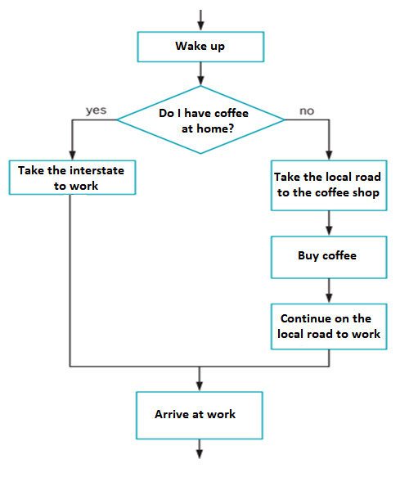
A Flow Chart

Slide 21
06
Boolean Expressions

Slide 22
Boolean Expressions
A Boolean expression is what goes inside the parentheses in an if
It’s also what goes inside the parentheses in a while
We now know how to create Boolean expressions for tests

Slide 23
07
Infinite Loops

Slide 24
Infinite Loops
Here is a loop
  i = 1;
  while (i < 3)
  System.out.println ("Hello");
How many times does this loop iterate?

Slide 25
08
Sentinel-Controlled Loops

Slide 26
Sentinel-Controlled Loops
A program contains a loop that
  Repeatedly asks how many parts should be ordered
  Continues until -1 is entered
The value of -1 is the sentinel value
  It’s not a valid value
  It is used to indicate that the loop should end

Slide 27
A Sentinel-Controlled Loop
  int testScore, totalScore = 0;
  System.out.print
  ("Enter a test score. Use -1 to exit. ");
  testScore = kb.nextInt();
  while (testScore >= 0)
  {
  totalScore += testScore;
  System.out.print
  ("Enter a test score. Use -1 to exit.");
  testScore = kb.nextInt();
  }

Slide 28
09
The do…while Loop

Slide 29
Loops 2: The do…while Loop
The do…while loop is similar to the while loop except
  The do…while loop tests after the loop iterates
This means the loop will execute at least once
We call a loop like this a post-test loop

Slide 30
An Example of a do…while Loop
int i = 0;
do
{ // These braces are necessary!
i++;
System.out.println (i);
}
while (i<10);
This prints 1, 2, 3, …, 10

Slide 31
THANKS!

